Slide 1
Waze Wizards
Data Drift 2025
Analysis of Traffic Data about casualties in Karnataka
Aranyi Sinha
Ruchi Sengupta

Slide 2
Introduction
In this study, a detailed analysis of traffic data has been carried out with a focus on understanding the patterns and causes of road accidents across various regions. With the continual increase in urbanization and vehicular movement, traffic congestion and road safety have emerged as major concerns. To address these challenges, real-world traffic datasets were utilized, comprising variables such as vehicle dimensions, location coordinates, time of occurrence, road types, and accident severity. The data has been systematically cleaned, processed, and analyzed using analytical tools, with the objective of identifying high-risk zones, peak accident hours, and contributing factors such as human error, weather conditions, and road infrastructure issues. Trends across different time frames, districts, and driving conditions have been studied to detect recurring patterns and anomalies that could inform proactive interventions. Visualizations and dashboards have been developed to present the findings in an accessible and interpretable manner. These outputs are intended to support evidence-based decision-making, allowing traffic authorities and policymakers to implement safety measures, reduce accident rates, and enhance overall traffic efficiency. Through this analysis, meaningful insights into traffic behavior and accident dynamics have been generated to aid future planning and road safety improvements.

Slide 3
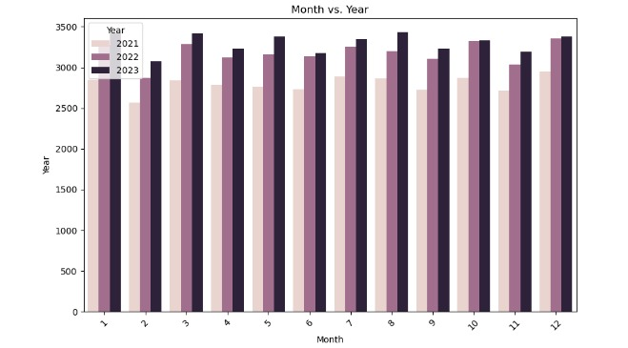
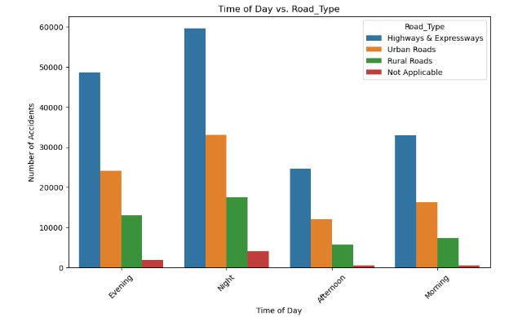
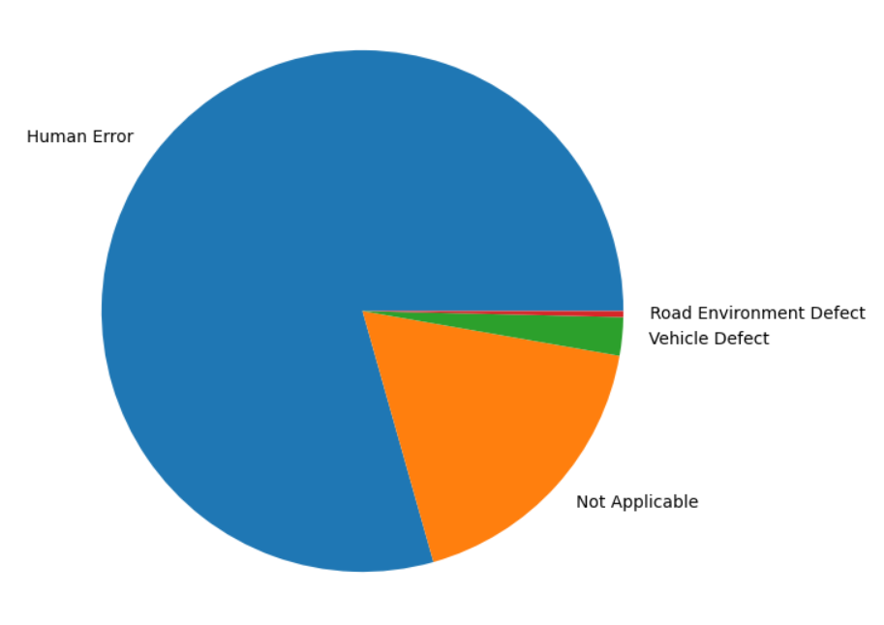
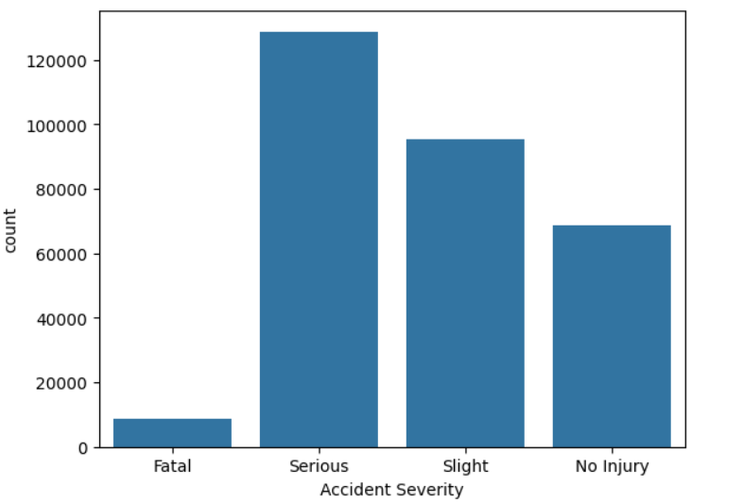
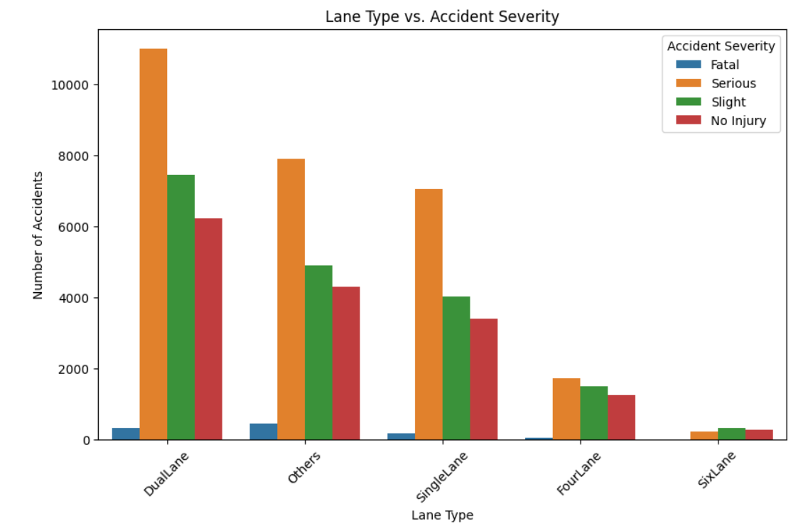
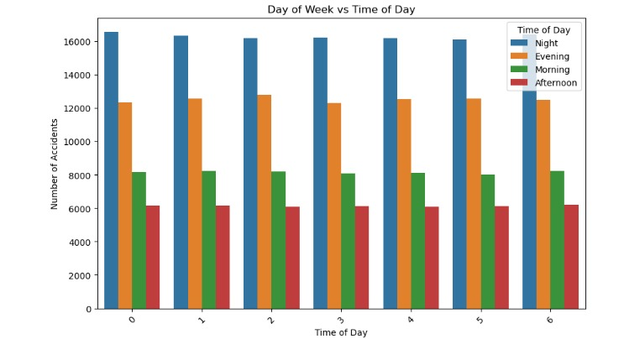
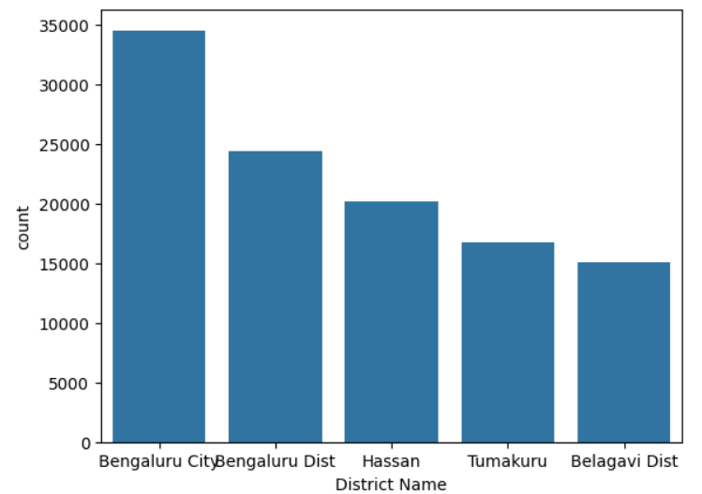
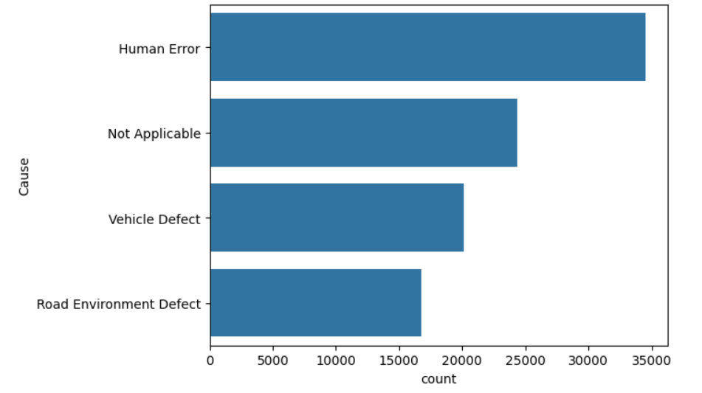
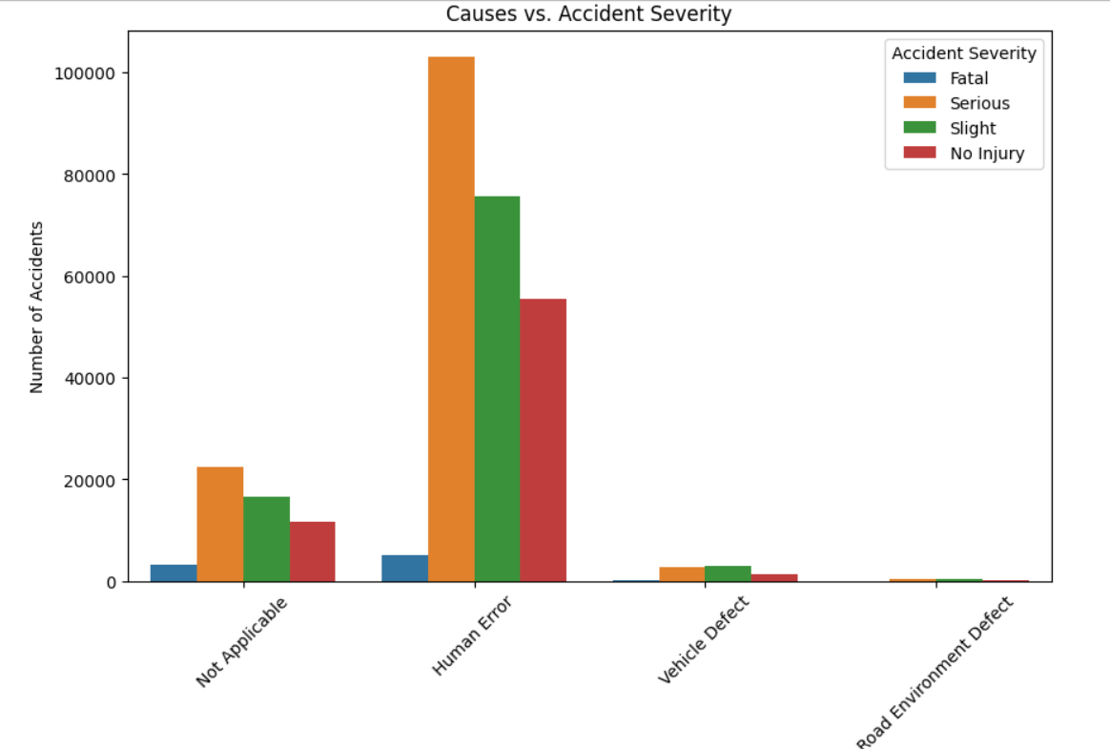
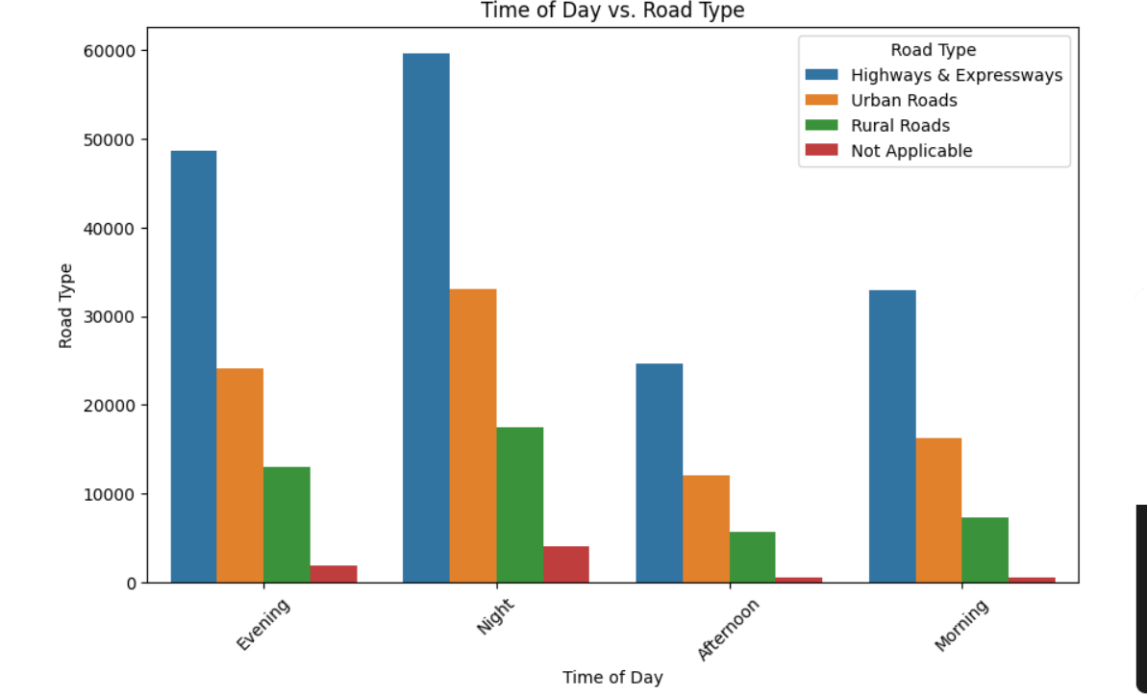
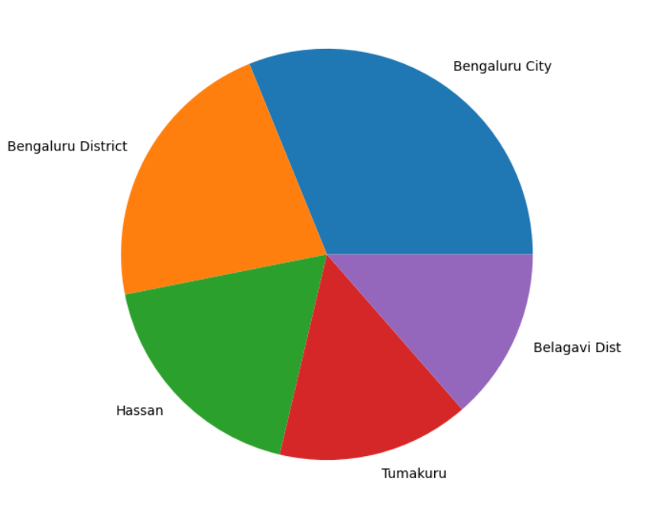
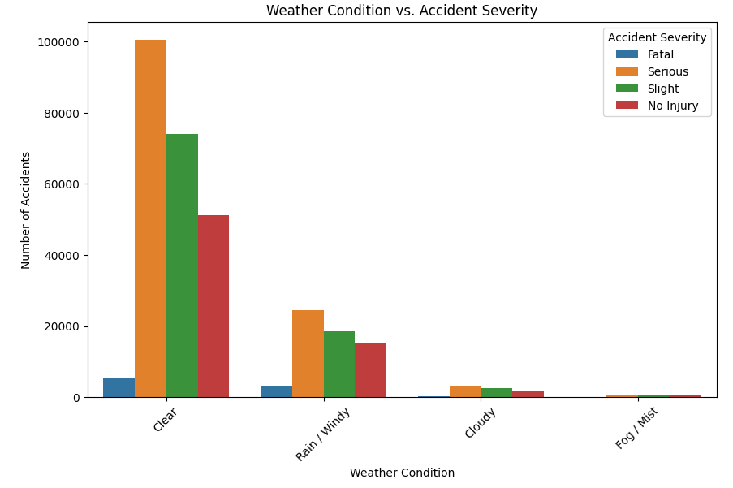
DATA DRIFT- 2025, TRAFFIC DATA ANALYSIS
TOP 5 CAUSES OF ACCIDENTS
TOP 5 DISTRICTS WITH MOST ACCIDENTS

Slide 4

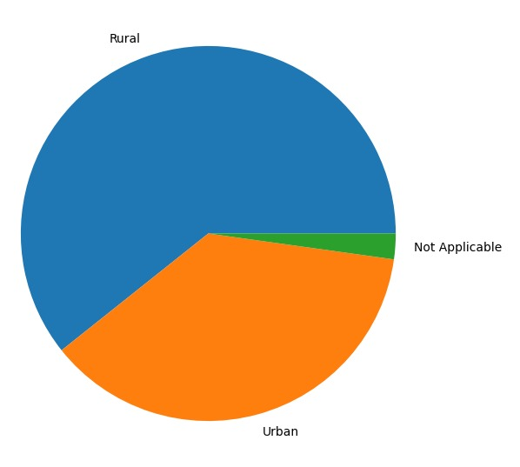
From the pie chart, we can see that human errors are the major causes of accidents.
From the pie chart, we can see that most accidents occur in rural areas, followed by urban areas.

Slide 5
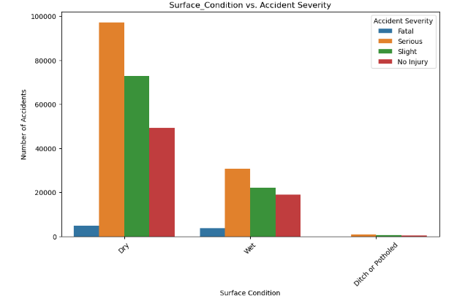
How Surface Conditions affect Accident Severity
From this bar graph we can see that dry surface conditions cause the greatest number of Serious accidents

Slide 6
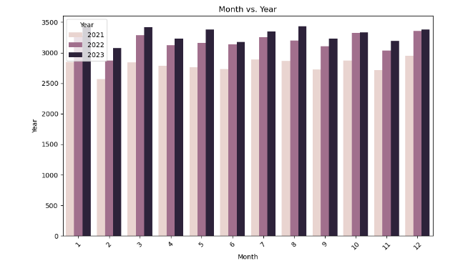
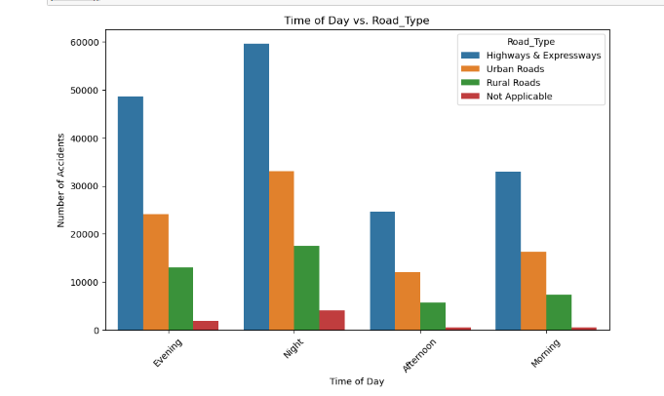
Graph showing monthly casualties from 2021 to 2023.
June had the least number of casualties across the years.
The graph shows that the greatest number of accidents occur during nights on Highways and Expressways

Slide 7
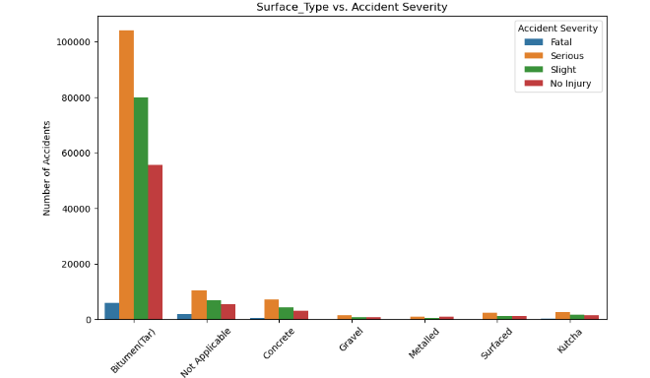
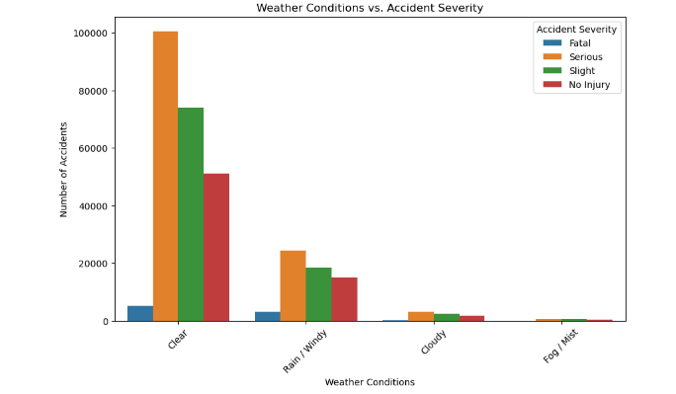
The graph shows that the greatest number of accidents take place on bitumen roads.
The graph shows that the greatest number of accidents take place in Clear Weather Conditions

Slide 8
Conclusion
The analysis of the traffic dataset reveals several critical insights into accident patterns within Bangalore city and district. It has been observed that the majority of accidents occur on bitumen (asphalt) surfaces and dual-lane roads, particularly during the night hours. Despite clear weather conditions, a high number of accidents continue to take place, indicating that external environmental factors are not the primary contributors.
A significant proportion of these accidents are found to be of serious severity, and in most cases, the leading cause is human error—including speeding, distracted driving, and violation of traffic rules. This highlights the urgent need for interventions focused not only on infrastructure but also on driver behavior and road safety awareness.
Enhanced Night-Time Monitoring - Install more high-intensity street lighting and reflective road signs on dual-lane and bitumen roads. - Use CCTV surveillance and smart sensors to detect erratic driving during night hours.
Strict Enforcement of Traffic Laws - Increase the frequency of traffic patrols, especially during late hours. - Implement automated speed enforcement systems in accident-prone zones.
Public Awareness and Education - Launch city-wide road safety campaigns focusing on responsible driving, especially targeting youth and commercial drivers. - Make defensive driving training a requirement for license renewals.

Slide 9
4. Infrastructure Improvements - Add median barriers and rumble strips on dual-lane roads to prevent head-on collisions and alert sleepy drivers. - Improve lane markings and signboards, especially in poorly lit or congested areas.
5. Data-Driven Safety Planning - Continuously update accident data and use heatmaps and predictive analytics to identify new high-risk zones. - Work with urban planning and traffic engineering teams to redesign roads where frequent accidents occur.

Slide 10
Thank You

